Slide 1
Project Title : Disease prediction using questionaire
Team Id : 4335
College Name : R.N.G Patel Institute of Technology
Team Leader : Nisarg Patel
Team Members :
Shreya Panwala Priyanshi Patel
Utsav Patel Dev Desai

Slide 2
AGENDA
Your hospital website is based on the concept of getting prescriptions of health from online sources.
It takes a description as input and use nlp to find the root of the problem. In this busy world people rarely go to hospital when it comes to small diseases. But those small diseases can sometimes lead to big massive problem that are some times deadly.
This website will be available free on the net and accessible from anywhere 24x7.

Slide 3
PROBLEM STATEMENT
Problem of need to go to hospital for small diseases.
Reference : https://pure-good-heroes.fandom.com/wiki/WALL-E

Slide 4
PROJECT OVERVIEW
Your hospital is a website that will help to diagnose any basic disease and help with proper medication. People avoid going to hospitals due to long waiting period and high rate of payments even for small disease.
We are using nlp model to decide which disease is close match with the problem described. Then that response is shown to the user on the web page. This website will be available 24x7 this will help the problem of waiting in long lines. And the free cost will help save those large payments.
You can diagnose anytime anywhere as much as you want. This factor of availability will bring new consumers more and in addition to that free price can increase popularity more.
Technologies
Web development, Python, NLP, JSON

Slide 5
WHO ARE THE END USERS?
Patients
Possible patients
Doctors

Slide 6
THE WOW FACTOR IN OUR SOLUTION
It is available 24x7.
It is accessible from anywhere.
It is free of cost.
It saves time.
It helps in diagnosing problems.
Limitations :-
Due to lack of data only two diseases are given.
Need a large amount of medical data.

Slide 7
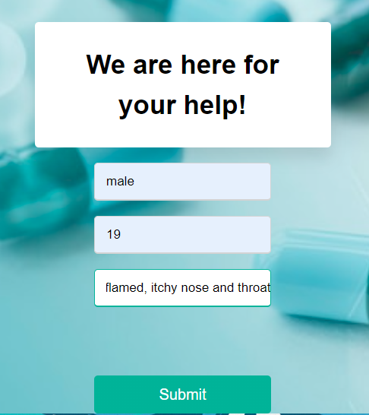
MODELLING

Slide 8
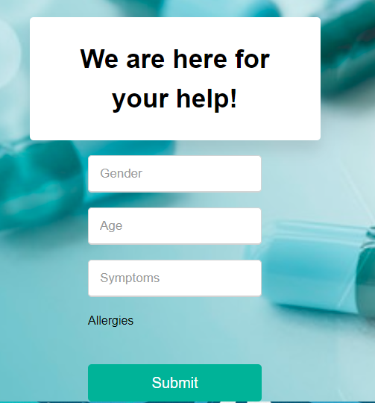
RESULTS

Slide 9
CONCLUSION
In conclusion this project has the capacity to save a top of lives. As well as it can also save time of users. With right amount of data, it has a scope to grow further and expand into an uncharted field. The merger of AI and health care can bring a lot of inovations for both doctors and patients.

Slide 10
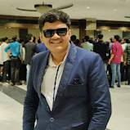
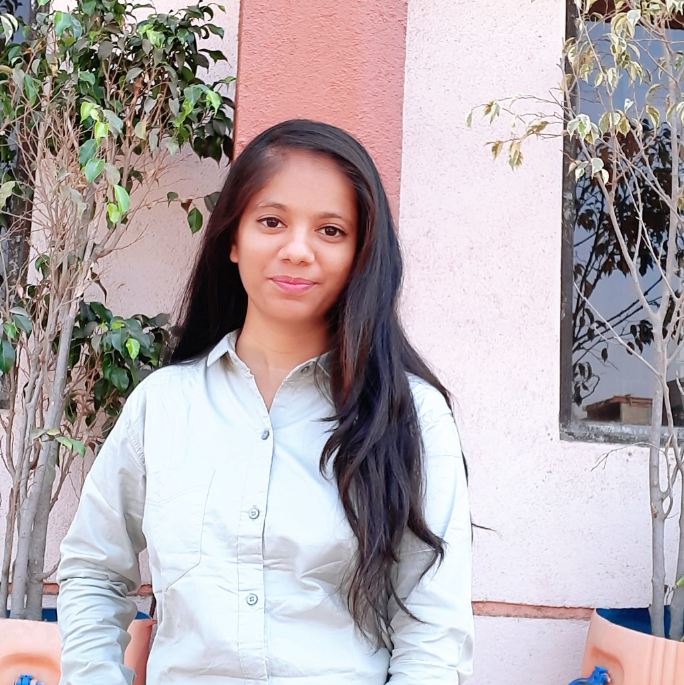
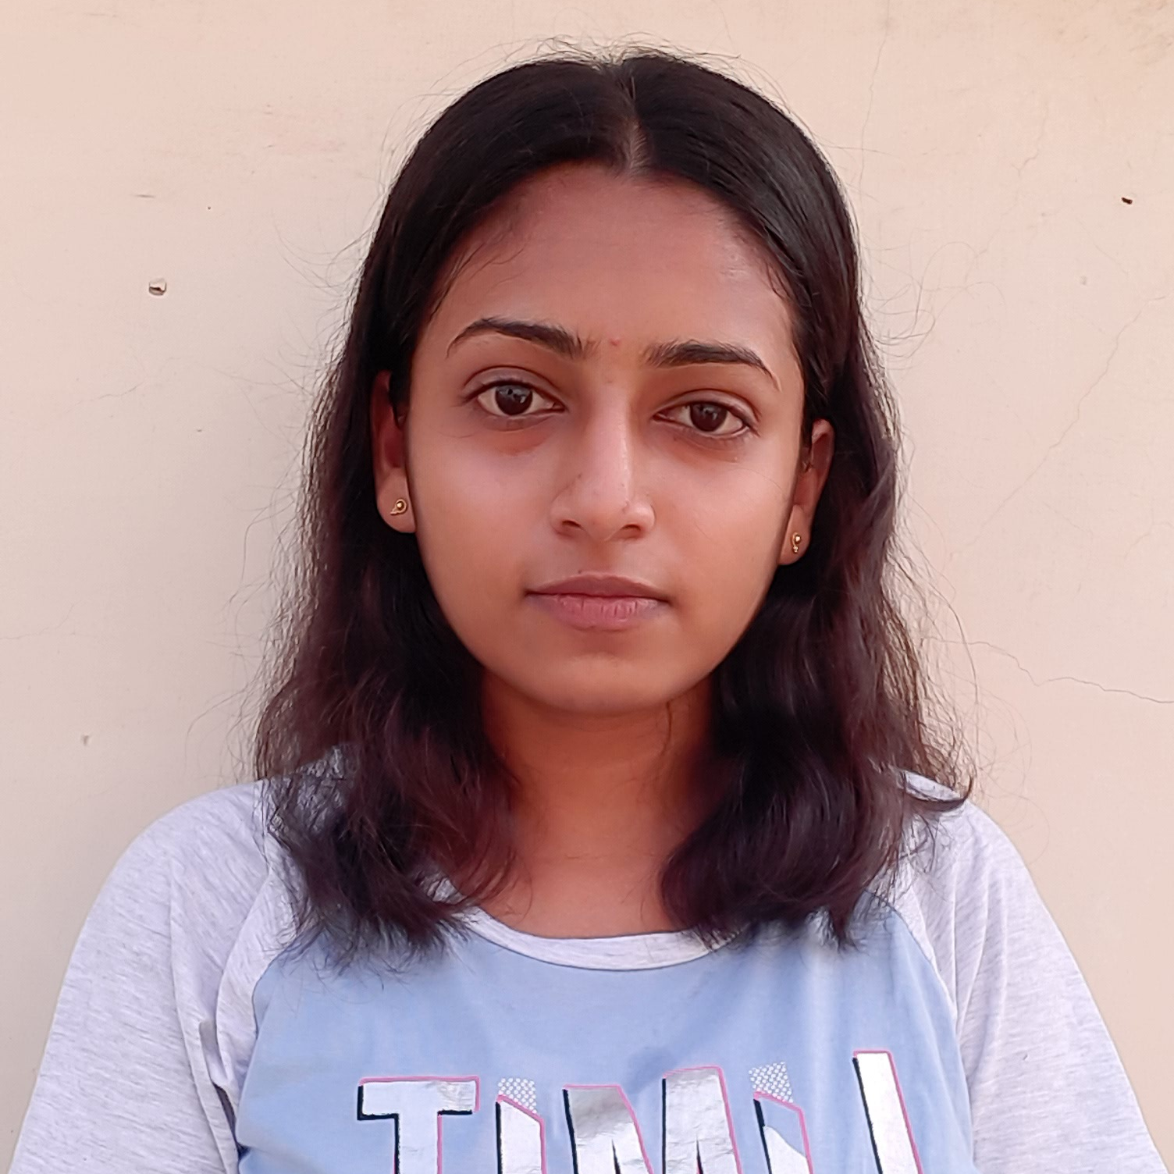
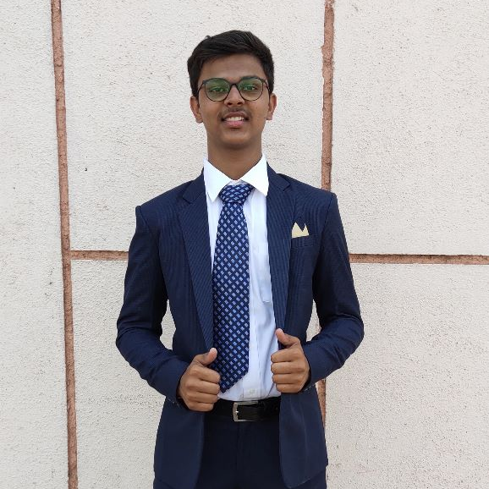
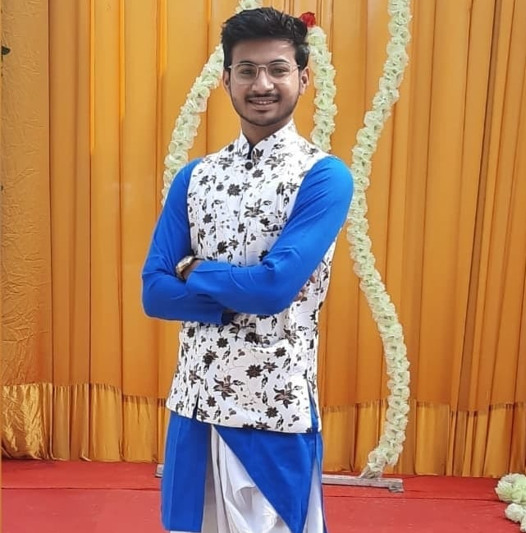
MEET OUR TEAM
Nisarg
Shreya
Priyanshi
Utsav
Dev

